Slide 1
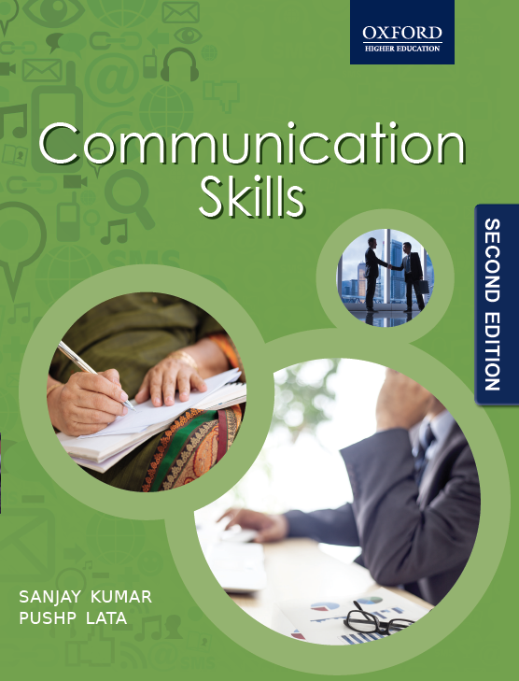
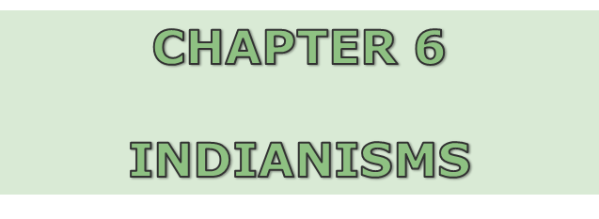
© Oxford University Press, 2015. All rights reserved.

Slide 2
Commonly Used Erroneous Expressions in Indian English
By walk
Dickey
Hail from
Good name
Co-brother/Co-sister
Bio-data and Jack
Purchase
Time is over
Lesson is delivered
Yesterday evening
Yesterday night
Footpath
Expire
Demise

Slide 3
Commonly Used Erroneous Expressions in Indian English
Carrying
Expecting
Better Half
Mrs.
Madam
Receive
See somebody at five fifteen
OK
How do you do?
Between…to
Bearer
Coolie
August audience
Colony

Slide 4
Commonly Used Erroneous Expressions in Indian English
Hotel
Innocently divorced
Lose
Keep firing somebody all the time
To put up
Tell me
Shifting one’s house
Come to one’s senses
Itself/only
Too good
Even I
Issue
Time pass
Give and exam
Guest/Visitor
Female
I don’t mind
Mixy
Heater
Bed Tea

Slide 5
Alternatives in Standard English Usage
By Walk | On Foot
Dickey | Boot
Hail from | Belong to
Cut Jokes | Crack Jokes
Good Name | Name

Slide 6
Alternatives in Standard English Usage
Tight Slap | Hard Slap
Marriage | Wedding
Get down | Get off
Off-On the light | Turn off/on…
Co-brother/Co-sister | Brother-in-law/Sister-in-law
Instructor-in-Charges | Instructors-in-Charge
Bio-data and Jack | Resume and Approach
Purchase | Buy
On Somebody’s Face | To someone’s face
Time is over | Time is up

Slide 7
Alternatives in Standard English Usage
Lesson is delivered | Lesson is given
Cannot engage my period… | Cannot take my class…
Pin drop silence | Perfect/Complete silence
Yesterday evening/night | Last evening/night
Footpath | Pavement
Expire | Pass away
Demise | Death
Carrying/Expecting | Pregnant
Mrs/Madam/Better half | Wife
Receive | Meet and bring home

Slide 8
Alternatives in Standard English Usage
See someone at five fifteen… | See someone at quarter past five…
How do you do? | How are you?
Between…to | Between…and/From…to
Bearer | Waiter
Coolie | Porter
August audience | Distinguished gathering
Hotel | Restaurant
Wheatish | Fair
Prepone | Advance
Innocently divorced | Divorced

Slide 9
Alternatives in Standard English Usage
To have eaten someone’ salt | To owe someone at lot…
Lose somebody… | Someone has gone missing…
To keep firing all the time… | To keep yelling at me…
To put up | Live…
Tell me… | How can I help you?
Shifting the house | Changing the house
Come to one’s senses | Regain consciousness
Too good | Very good
Even I | So do/did I
Issues | Children

Slide 10
Alternatives in Standard English Usage
Time pass | Average
Give an exam | Take an exam
Guest | Visitor
Female | Woman
I don’t mind… | Sure/Oh yes…
Mixy | Mixer
Tanki /Tunki | Overhead Tank
One-eyed man | A figure among ciphers
Heater | Blower
Bed Tea | Early Morning Tea

